Slide 1
Introduction to Statistical Thinking

Slide 2
Branch of statistics

Slide 3
Branch of statistics
The two major areas of statistics are known as descriptive statistics, which describes the properties of sample and population data, and inferential statistics, which uses those properties to test hypotheses and draw conclusions.

Slide 4
Descriptive Statistics
Some common statistical tools and procedures for descriptive statistics can be categorized into:
Measure of central tendency
Measure of spread
Measure of partition

Slide 5
Measure of central tendency
The most common measures of central tendency are the mean, median, and the mode. Measure of central tendency is also known as measure of location or average.

Slide 6
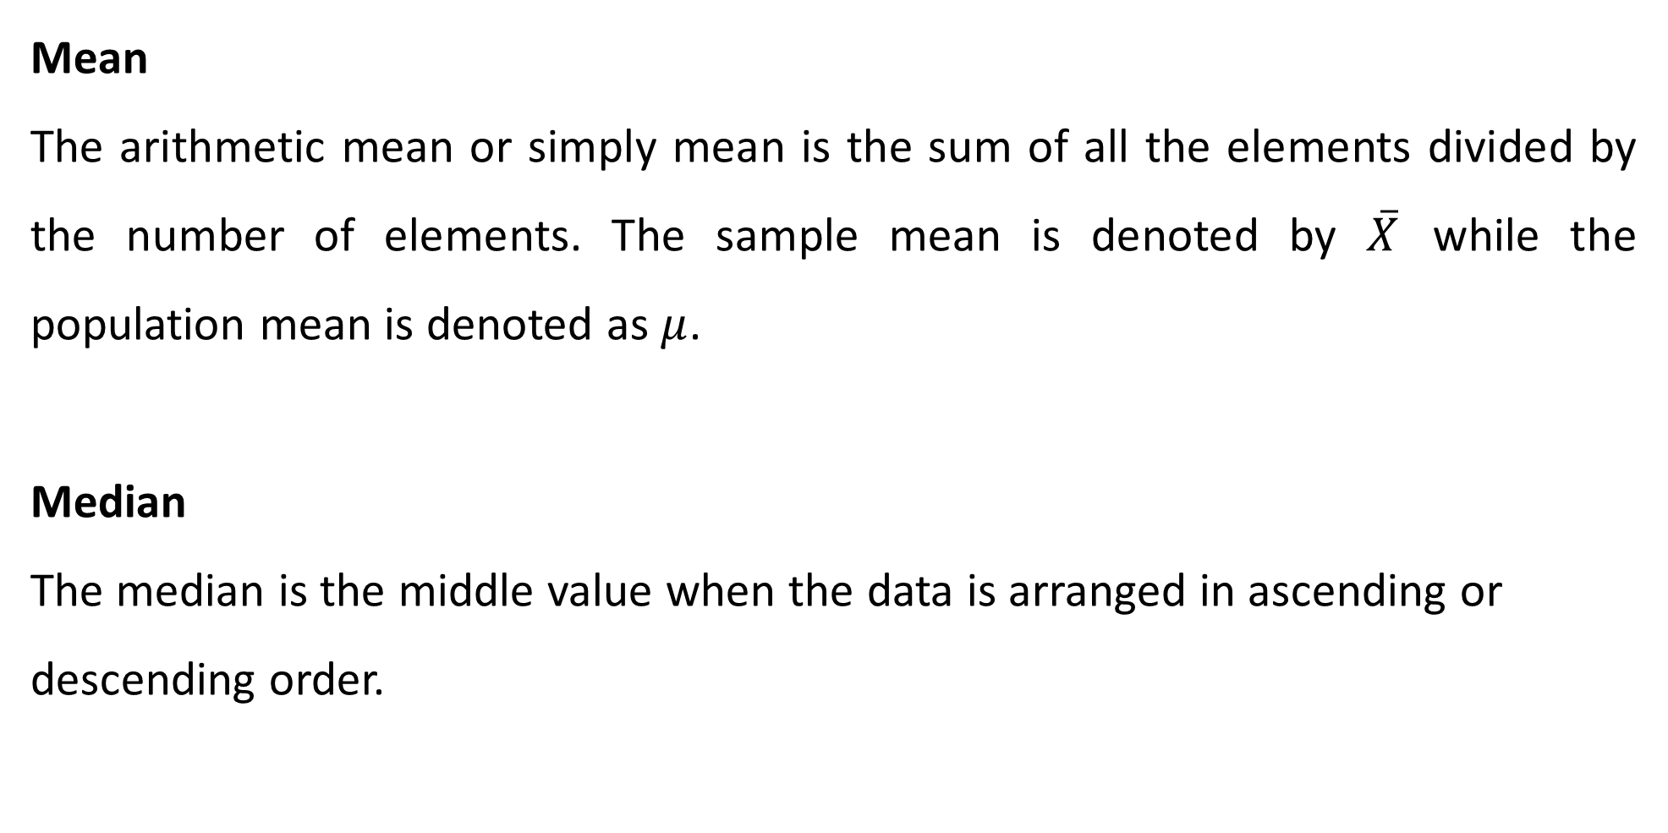
Measure of central tendency
Mean
The arithmetic mean or simply mean is the sum of all the elements divided by the number of elements. The sample mean is denoted by $\overset{‾}{X}$ while the population mean is denoted as $μ$.
Median
The median is the middle value when the data is arranged in ascending or descending order.

Slide 7
Measure of central tendency
Mode
The mode is the value that occurs the most frequently in the data set. You can easily get the mode by tabulating your dataset.

Slide 8
Measures of spread
A measure of spread also known as measure of dispersion is used to describe the variability in the data. That is, it tells us how wide the dataset is.
The most common measures of spread are:
Range
Standard deviation
Variance

Slide 9
Measures of spread
Range
The range is the difference between the highest and lowest values in a data set. It is the simplest measure of spread.
Variance
The variance is a measure of how far each value in the data set is from the mean. A small variance indicates that the data points tend to be very close to the mean and to each other. A high variance indicates that the data points are very spread out from the mean and from each other.

Slide 10
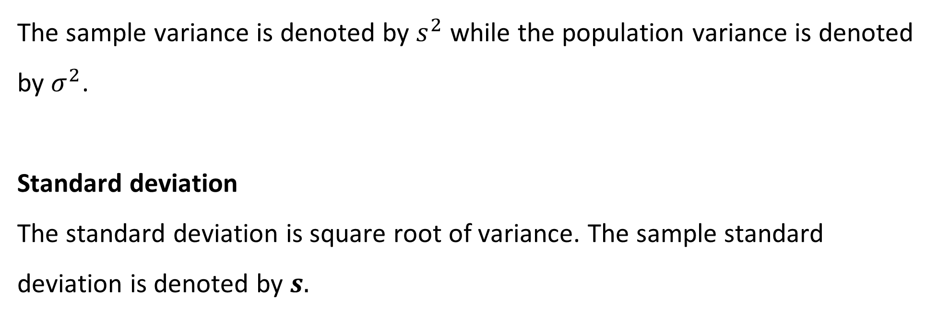
Measures of spread
The sample variance is denoted by $s^{2}$ while the population variance is denoted by $σ^{2}$.
Standard deviation
The standard deviation is square root of variance. The sample standard deviation is denoted by $s.$

Slide 11
Measures of partition
Measures of partition are measures that divide a distribution into specified number of parts.
The following are the most common measure of partition:
Quartiles
Percentile

Slide 12
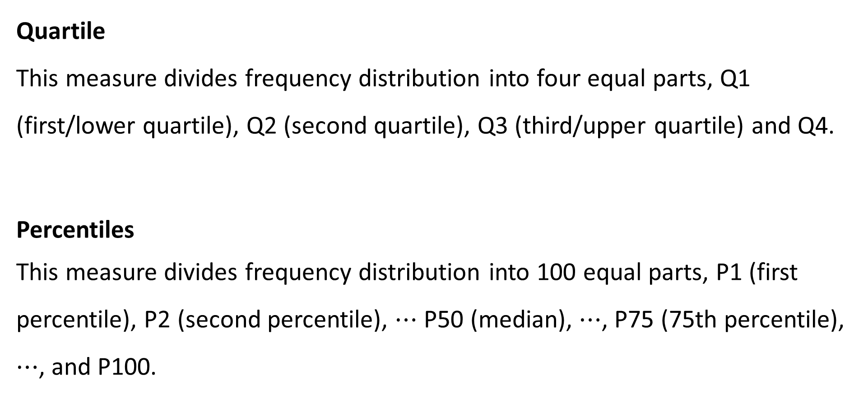
Measures of partition
Quartile
This measure divides frequency distribution into four equal parts, Q1 (first/lower quartile), Q2 (second quartile), Q3 (third/upper quartile) and Q4.
Percentiles
This measure divides frequency distribution into 100 equal parts, P1 (first percentile), P2 (second percentile), $⋯$ P50 (median), $⋯$, P75 (75th percentile), $⋯$, and P100.

Slide 13
Introduction to five number summary
The five-number summary in statistics is a set of descriptive statistics that provides information about a dataset. It consists of the five most important basic statistics:
the minimum (smallest observation)
the lower quartile or first quartile
the median (the middle value)
the upper quartile or third quartile
the maximum (largest observation)

Slide 14
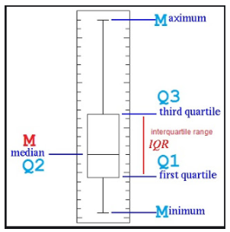
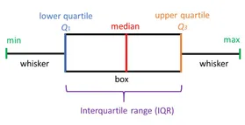
A box plot
A boxplot can be used to show or represent the five-number summary.

Slide 15

Lab session
Open Statistical Thinking 1 Jupyter Notebook

